Slide 1
2022 JDP -
AI Detection and Causality Inferences for Fab Operations
Advisor: Wen-Chih Peng
Student: Zheng-Ming (Paul) Lin, Ching (Jason) Chang, (Ivan Kakhaev)
Date: 2022/03/10

Slide 2
Outline
Paper Survey
Log anomaly detection -- log parsing, log mining, log dataset
Log anomaly detection with GNN
Root cause analysis

Slide 3
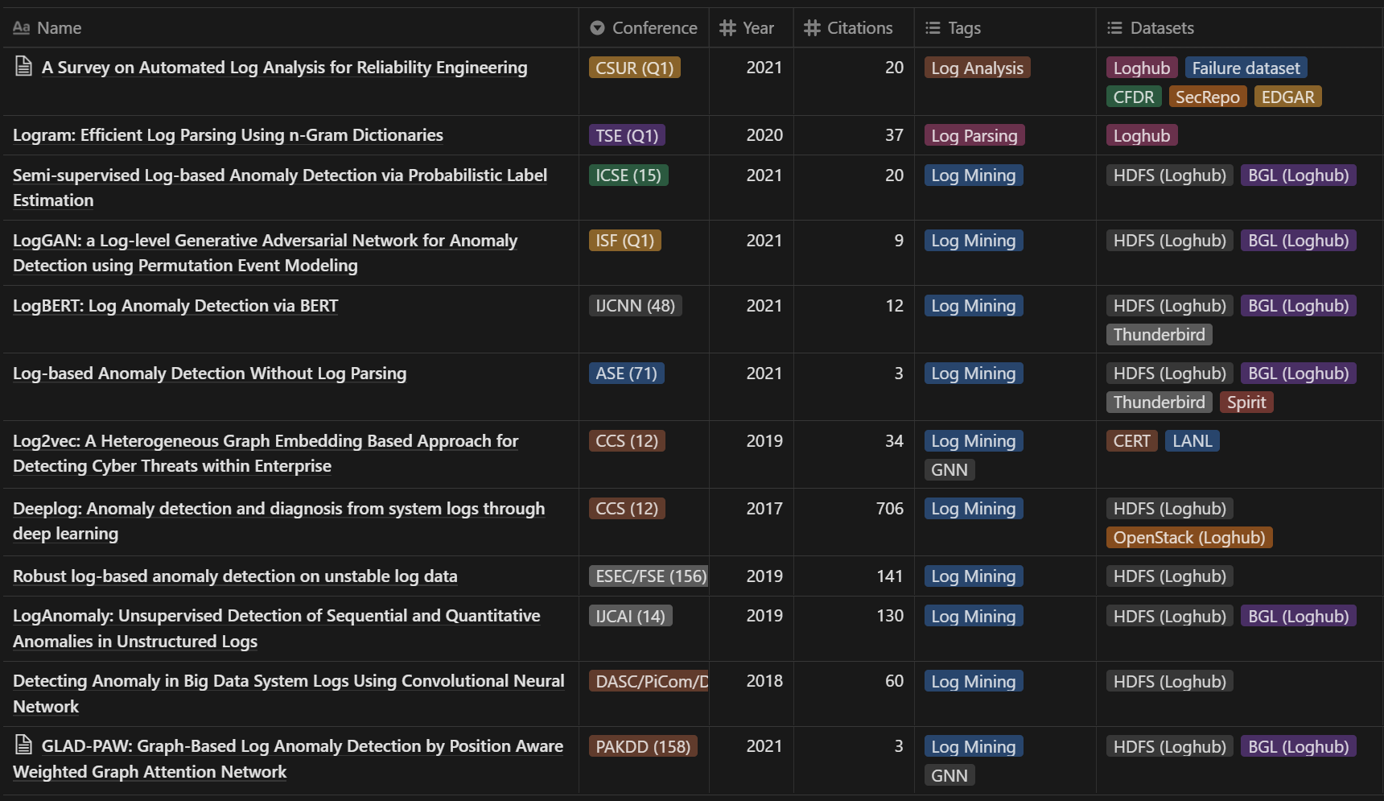
Paper Survey – Log anomaly detection

Slide 4
Log Parsing, Log Mining, Log Dataset
Log Parsing | Log Mining | Log Dataset
DRAIN, Logram | LogCluster, DeepLog, LogAnomaly, GLAD-PAW | HDFS, BGL

Slide 5
Paper Survey – Log anomaly detection with GNN
GLAD-PAW: Graph-Based Log Anomaly Detection by Position Aware Weighted Graph Attention Network [PAKDD 2021]

Slide 6
GLAD-PAW: Graph-Based Log Anomaly Detection by Position Aware Weighted Graph Attention Network
Wan, Yi, et al. "GLAD-PAW: Graph-Based Log Anomaly Detection by Position Aware Weighted Graph Attention Network." Pacific-Asia Conference on Knowledge Discovery and Data Mining. Springer, Cham, 2021.

Slide 7
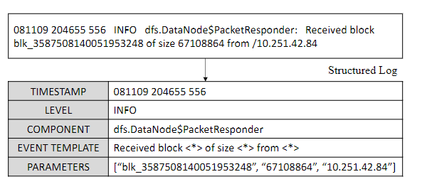
Log Parsing
Most of the existing log mining tools require structured input data
We need to parse the semi-structured log messages into structured log events

Slide 8
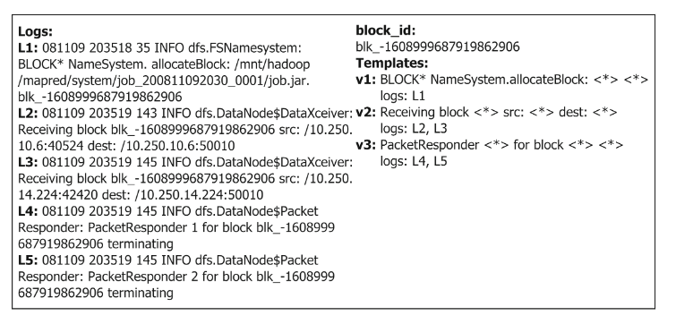
Log Partition (or Session Creation)
Parsed logs are usually grouped by one of the three following windows
fixed window
sliding window
session window (this paper)

Slide 9
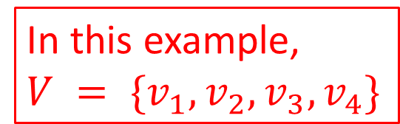
Log Partition (or Session Creation)
Group events into session
Logs:
L1, L2, L3, L4, L5, L6, L7, L8, L9, L10
Blocks:
b1, b2, b1, b1, b2, b1, b2, b1, b2, b2
Templates:
v1, v2, v1, v3, v4, v1, v2, v4, v3, v3
b1: v1, v1, v3, v1, v4
b2: v2, v4, v2, v3, v3

Slide 10
Related Work – Log Anomaly Detection
Maching Learning
Principal component analysis (PCA) constructs normal and abnormal subspaces, and computes the squared distance of the projection of event frequency vectors onto the anomaly subspace.
Invariant Mining method tries to estimate the invariant space via singular value decomposition (SVD) on the input matrix
Log Clustering clusters the logs to ease log-based problem identification and utilizes a knowledge base to check if the log sequences occurred before.
Isolation Forest constructs isolation trees assuming that anomalies are more susceptible to isolation.

Slide 11
Related Work – Log Anomaly Detection
Deep Learning
DeepLog models log sequences as natural language and utilize Long Short-Term Memory (LSTM) architecture to learn log patterns from normal executions.
LogAnomaly adds attention mechanism and frequency features to DeepLog

Slide 12
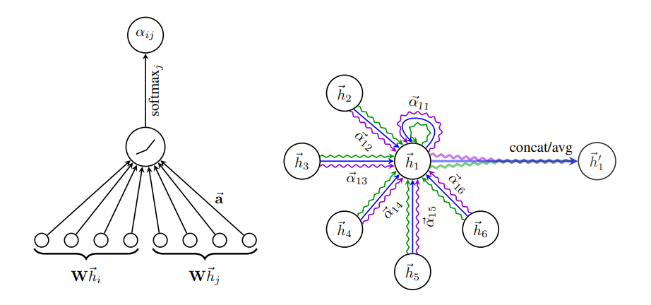
Related Work – GNN
GAT

Slide 13
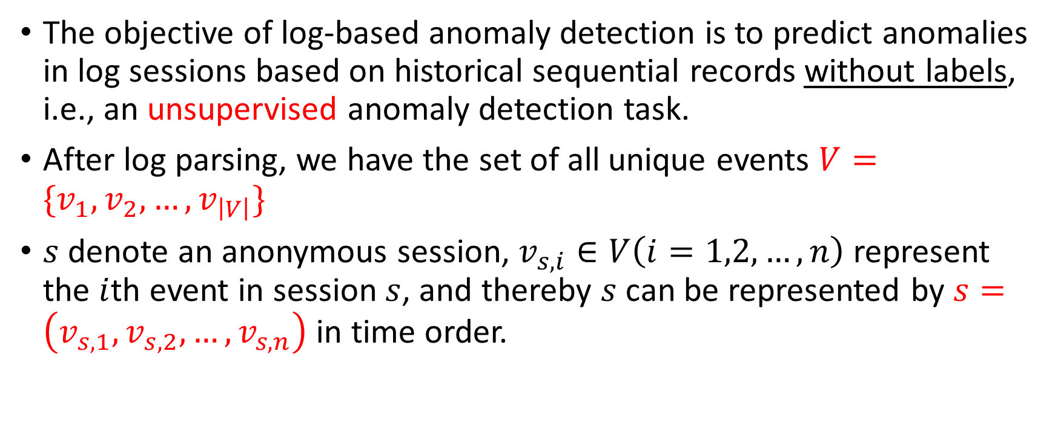
Problem Formulation

Slide 14
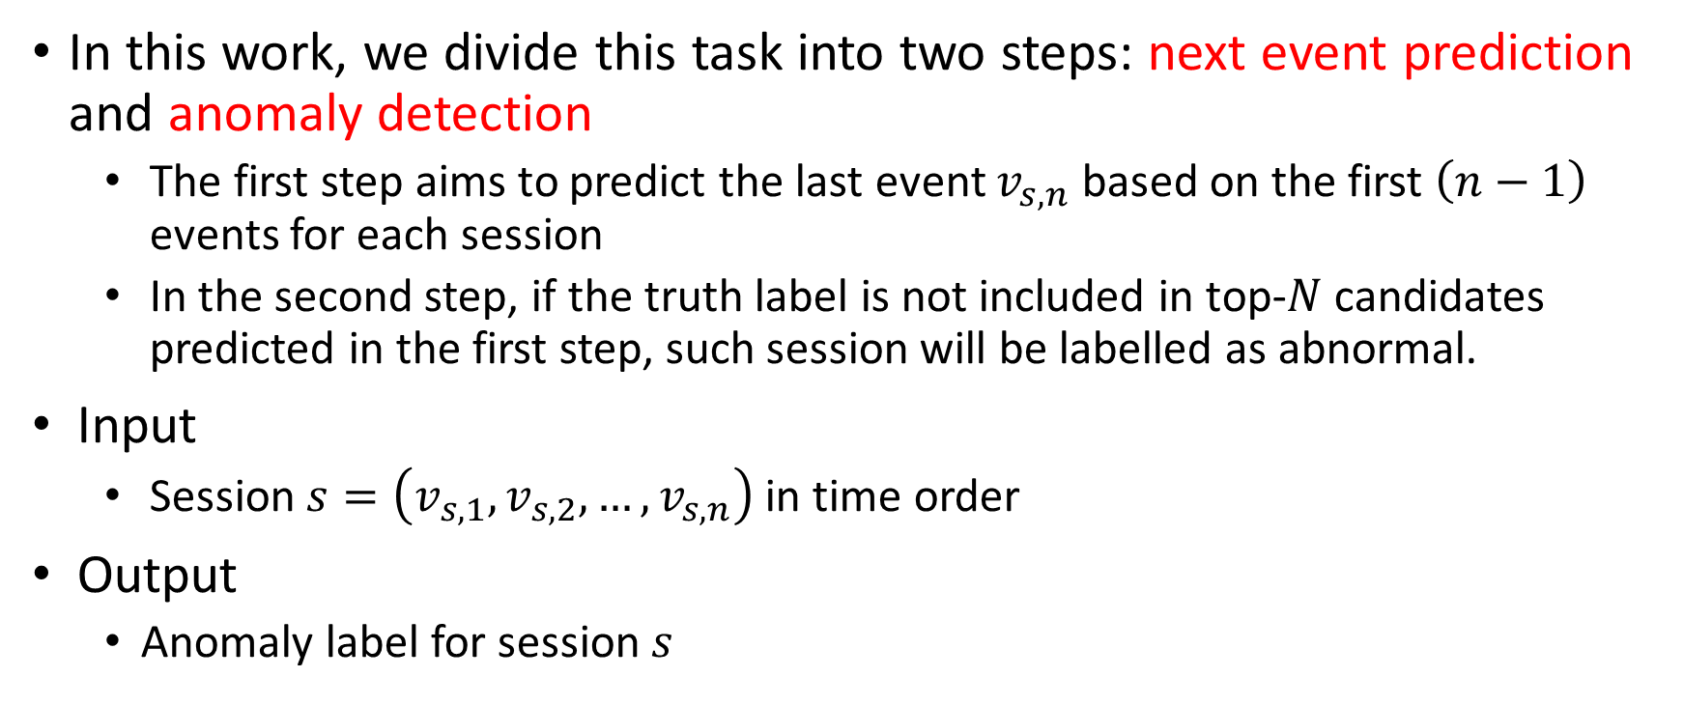
Problem Formulation

Slide 15
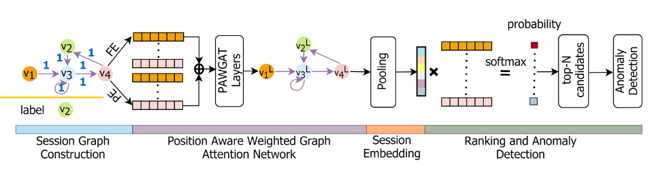
The overall architecture of GLAD-PAW

Slide 16
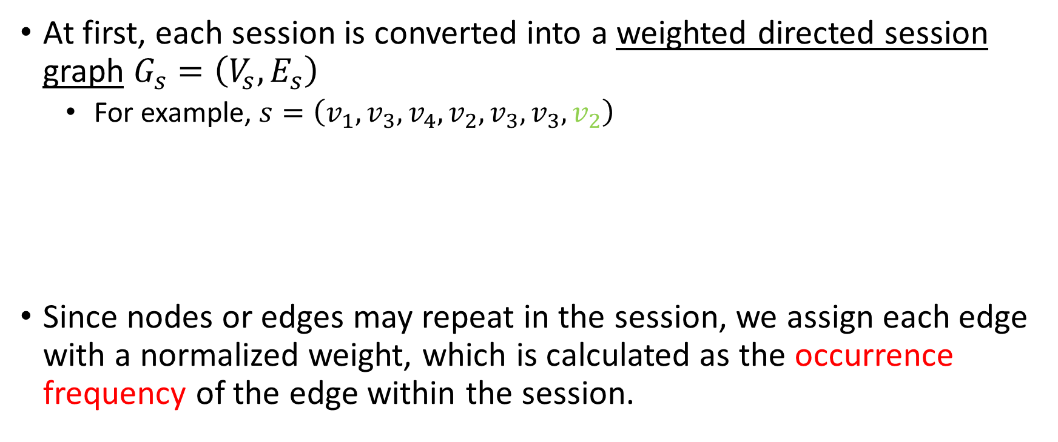
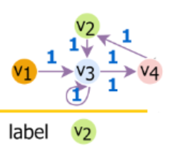
Session Graph Construction

Slide 17
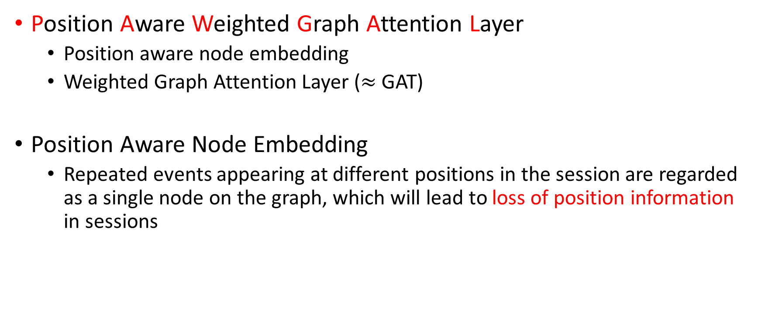
PAWGAT

Slide 18
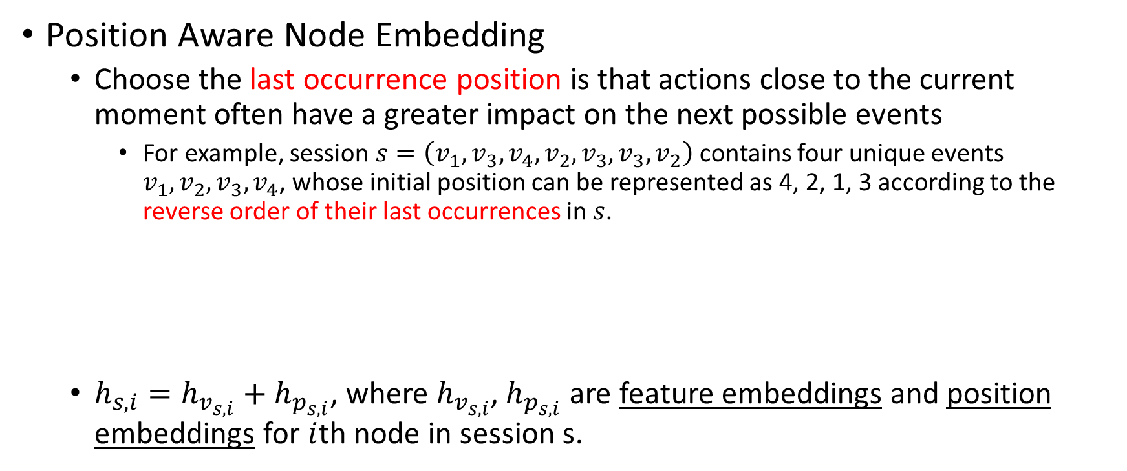
PAWGAT
v1:
v2:
v3:
v4:
4
2
v1, v3, v4, v2, v3, v3, v2
1
3

Slide 19
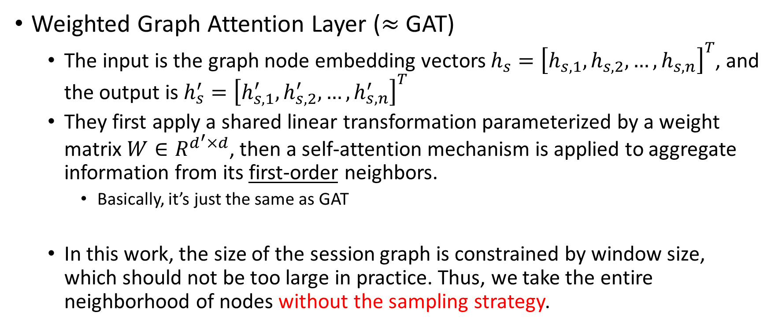
PAWGAT

Slide 20






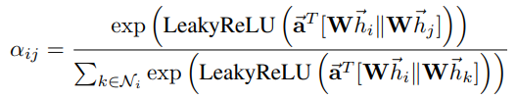
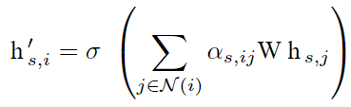
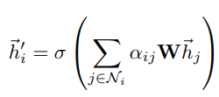
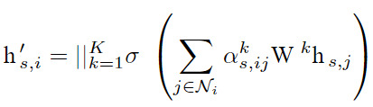

PAWGAT
The only difference: here they also consider the edge’s weight
In this Paper
GAT

Slide 21
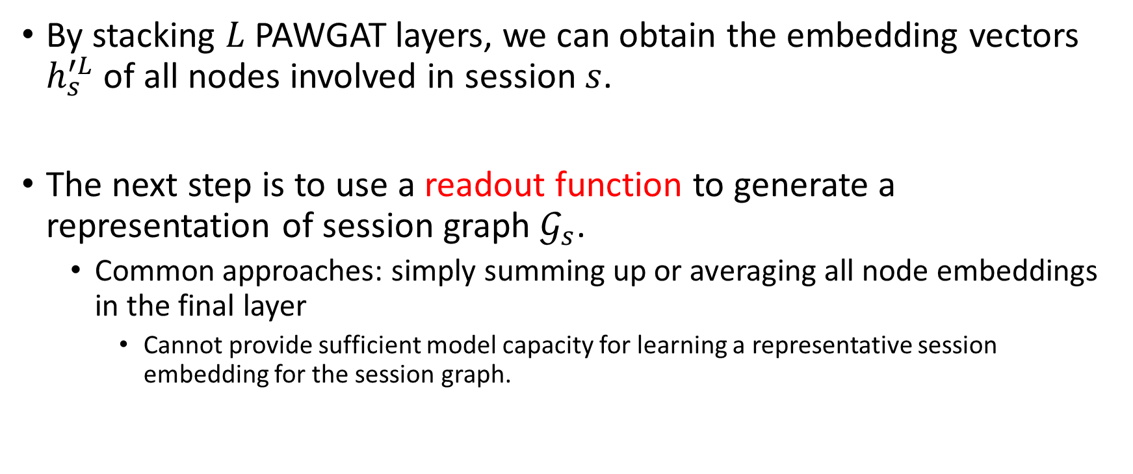
Session Embeddings

Slide 22
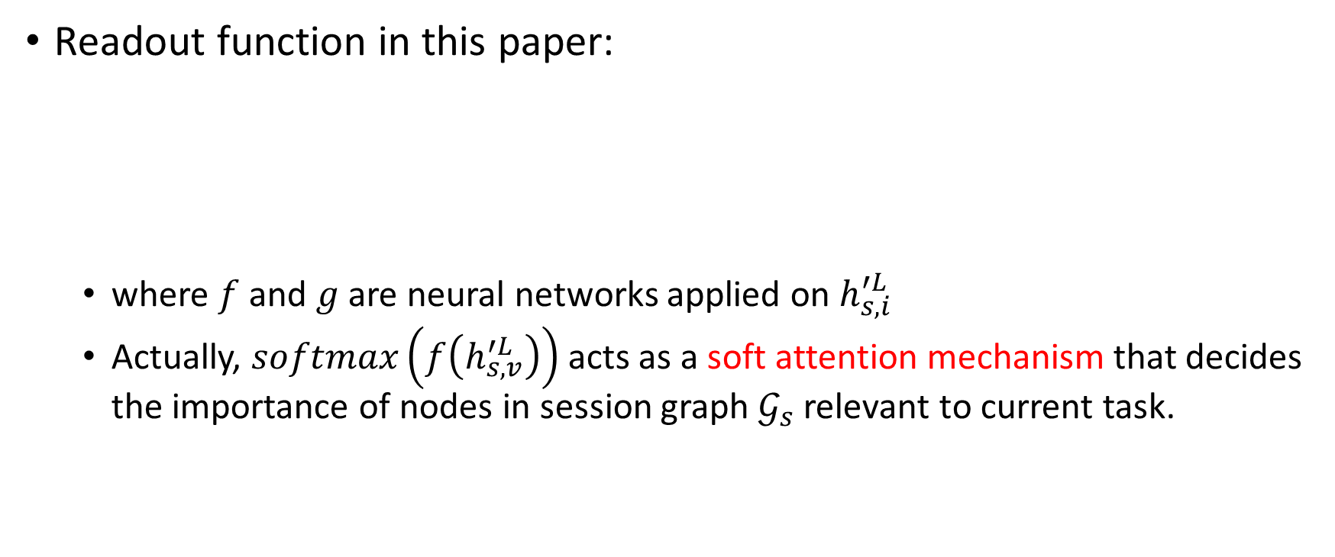
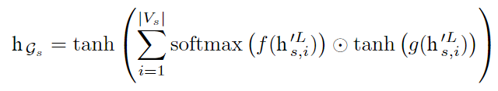
Session Embeddings

Slide 23
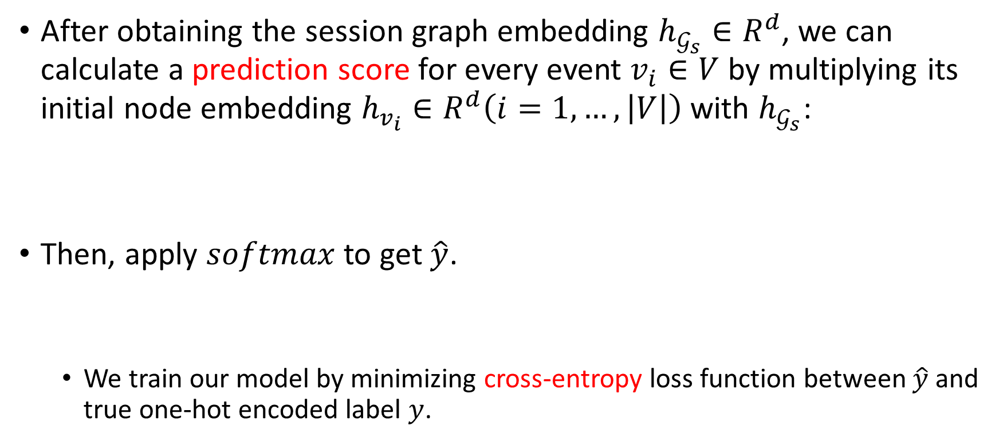


Prediction and Anomaly Detection

Slide 24
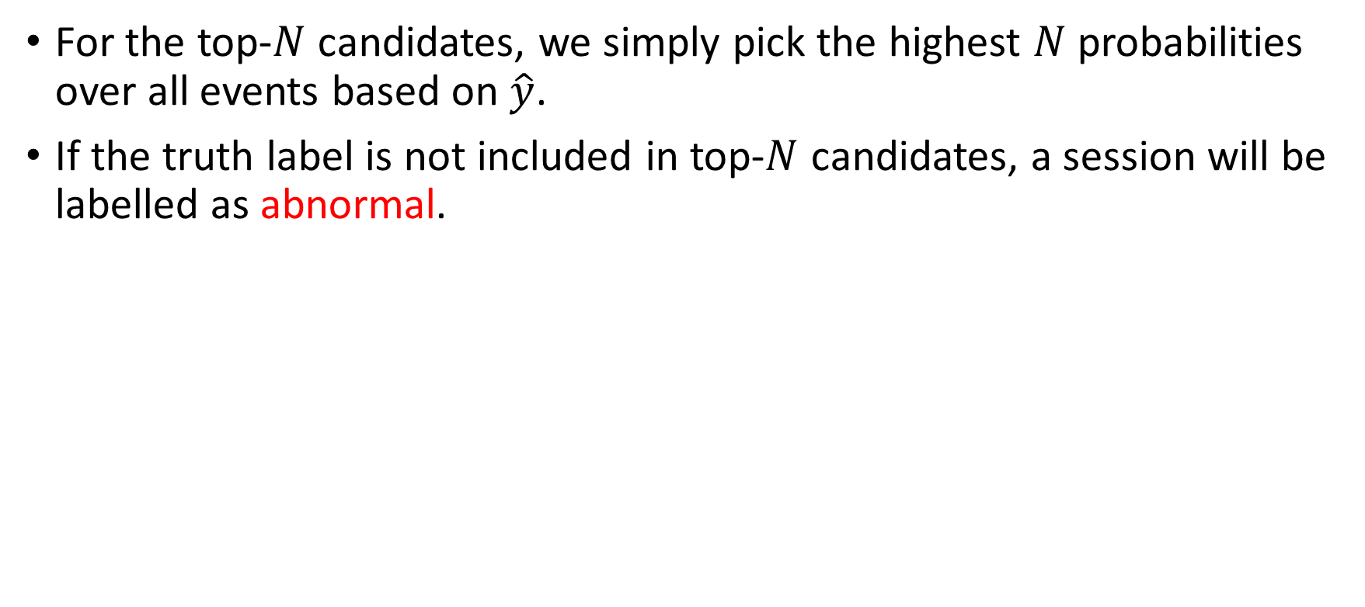
Prediction and Anomaly Detection

Slide 25
Evaluation
Does GLAD-PAW achieve the state-of-the-art performance?
How does PAWGAT layer work for anomaly detection problem com-pared with other graph layers (including ablation test)?
How do the key hyperparameters affect model performance, such as the graph layer and number of heads?

Slide 26
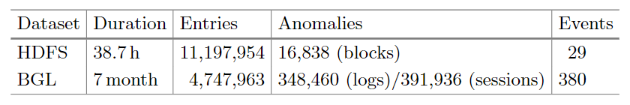
Dataset
HDFS
HDFS dataset is generated and collected from Amazon EC2 platform through running Hadoop-based map-reduce jobs.
BGL
BGL dataset is Blue Gene/L supercomputer system logs, which consists of 128K processors and is deployed at Lawrence Livermore National Laboratory (LLNL)

Slide 27
Things to be aware of
They randomly take 80% of normal sessions as training data and the rest 20% normal sessions along with all abnormal sessions as test data.
Since anomalies are rare in real life, instead of using Accuracy (very likely to achieve values close to 1), they use Precision, Recall and F1-measure as the evaluation metrics in their experiments.
BGL dataset contains a number of out-of-vocabulary (OOV) events, which are events that have never seen in the training set.

Slide 28
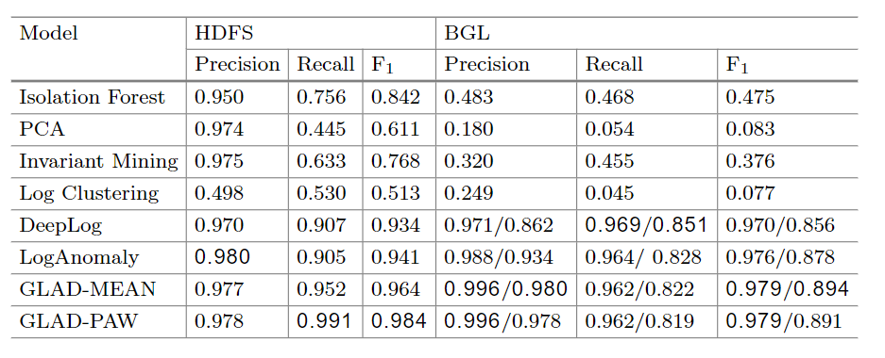
Comparison with Baseline Models

Slide 29
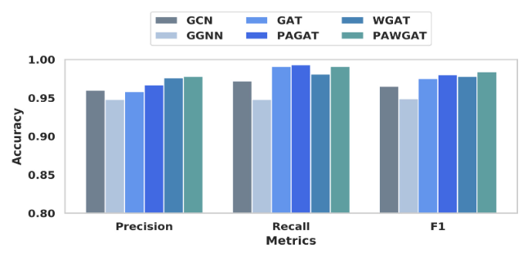
Comparison with Other GNN Layers

Slide 30
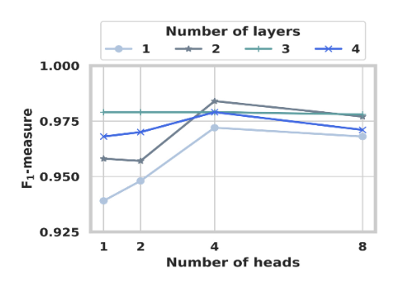
Parameter Sensitivity
Number of layers
Number of heads

Slide 31
Conclusion
Propose a novel architecture GLAD-PAW for log-based anomaly detection that incorporates graph models in representing log sessions
GLAD-PAW constructs directed session graphs from log records and applies a novel position aware weighted graph attention network (PAWGAT) to generate informative representations for all events.
Extensive evaluation on large system logs have clearly demonstrated the superior effectiveness of GLAD-PAW compared with previous methods.

Slide 32
My opinions
Pros
The very first paper to use GNN in log anomaly detection
It uses the unsupervised manner to train the model
They consider the position information
Cons
It’s an offline method (must have the “event bank”, so it cannot deal with unseen events)
Didn’t try other log parsing techniques
Didn’t consider the most important hyperparameters N in their experiments
They only use normal sessions to train the model, which is not right under the unsupervised premise

Slide 33
Paper Survey – Root cause analysis
AutoMAP: Diagnose Your Microservice-based Web Applications Automatically [WWW 2020]
CloudRCA: A Root Cause Analysis Framework for Cloud Computing Platforms [CIKM 2021]

Slide 34
AutoMAP: Diagnose Your Microservice-based Web Applications Automatically
Meng Ma, Jingmin Xu, Yuan Wang, Pengfei Chen, Zonghua Zhang, Ping Wang
WWW 2020

Slide 35
Problem

Slide 36
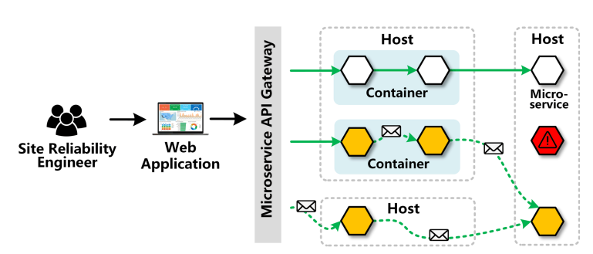
Problem
Indirect anomaly propagation
Single type of metric is not enough to characterize the anomalies occur in diverse services

Slide 37
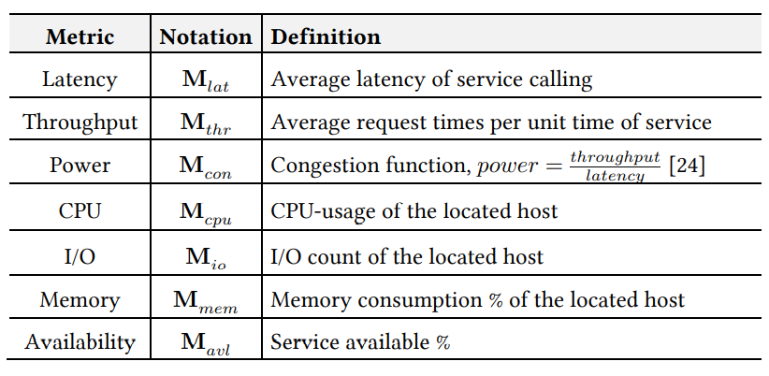
Problem Statement
Input:
Front-end service v(fe) ∈ V during the incident period ℓ
|V| = n is the number of services
Each service has m types of metrics
[M_{k}] ∈ n x l
Output:
To identify a set of services v(rc) ⊂ V that causes the observed anomaly in v(fe)

Slide 38
Solution

Slide 39
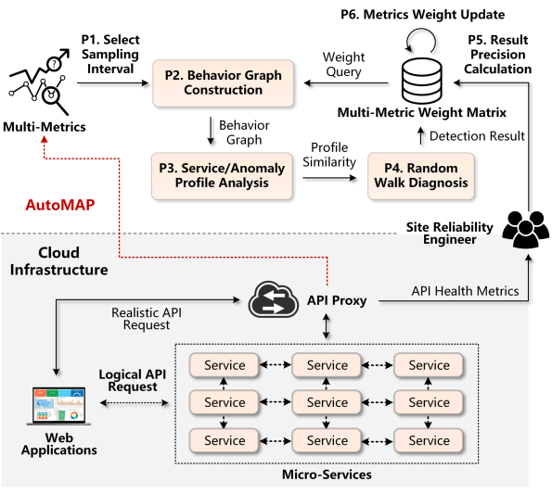
AutoMAP Framework
P1: Select a sampling interval parameter
P2: Construct the anomaly behavior graph
P3: Extract the profile of anomaly using “+” and “−” operations
P4: Conduct root cause detection algorithm
P5: Verify the result and calculate the precision
P6: Update the metric-weight matrix
Notes:
Graph augmented normalizing flow 就是多了這個adjacency matrix 當作 condition
factorize 1 series domain -> bayesian network
2 temporal dimension -> conditional normalizing flow

Slide 40
Select sampling interval
It may produce redundant fluctuatuions due to sampling too frequently
Many effective metric changes will be lost because of a larger interval
Thus, compute the interval by a frequency-weighted average of request interval

Slide 41
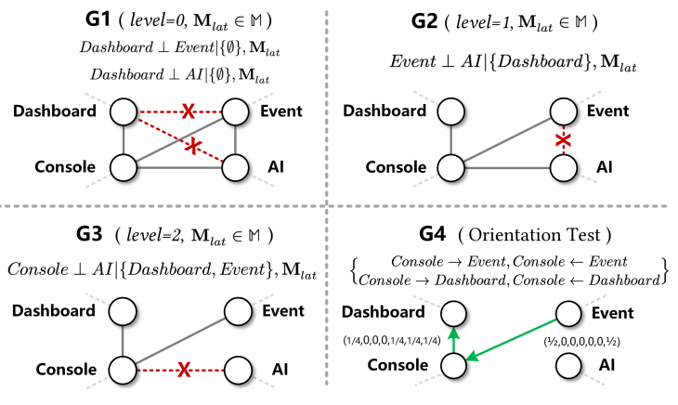
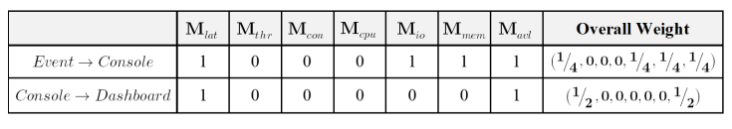
Behavior Graph Construction
Step1: Generate a complete, undirected and fully weighted graph
W i,j,k = 1 for ∀ i, j ∈ [1, n] and ∀ k ∈ [1, m]
Step2: For each type of metric M_{k} , test conditional indepedence of any pairs of vi, vj
Set W i,j,k = 0 if they are conditional indepedence
Step3: Remove edge e i,j if W i,j,k = 0
Step4: Orientation test

Slide 42
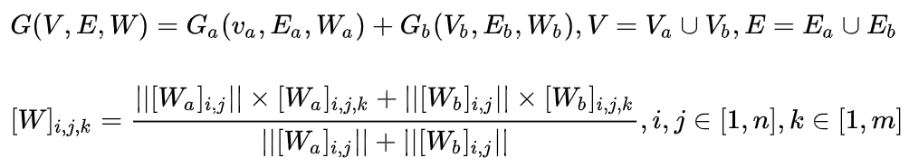
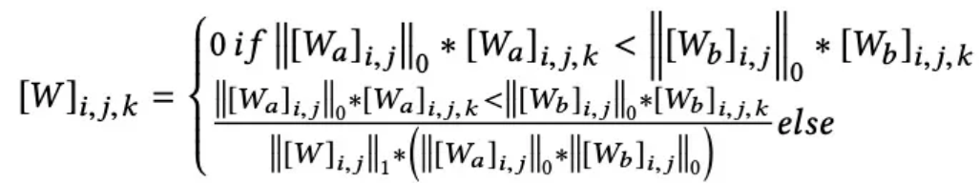
Addition Operation and Subtraction Operation
Without any prior knowledge, it’s a challenge to classify various services according to their characteristics
Use multiple historical observations of metrics in normal status
Aggregate the behavior graphs using normal metrics
A small number of services contribute to the anomaly propagation
Remove the redundant correlations from the behavior graph

Slide 43




Root Cause detection algorithm
Service correlation
Random walk algorithm
Forward Transition: A random visitor walks from service vi to vj with probability pi,j if eij = 1
Self Transition: The visitor to stay longer on its currently-visiting service
Backward Transition: The visitor is visiting a particular service with low correlation score

Slide 44
Conclusion
Problem
Single type of metric is not enough to characterize the anomalies occur in diverse services
Solution
Construct behavior graph
Use random walk to determine which service is root cause

Slide 45
CloudRCA: A Root Cause Analysis Framework for Cloud Computing Platforms
Yingying Zhang, Zhengxiong Guan, Huajie Qian, Leili Xu, Hengbo Liu, Qingsong Wen, Liang Sun, Junwei Jiang, Lunting Fan, Min Ke
CIKM 2021

Slide 46
Problem

Slide 47
Problem
The limited coverage of log features makes it difficult for log-based methods
Correlation analysis-based methods don’t consider the topology of infrastructures and other domain knowledge

Slide 48
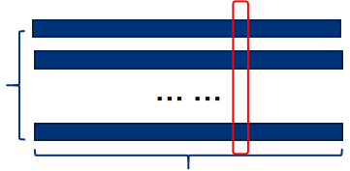
Problem Statement
Input: N constituent series with D attributes and of length T
X = (X1 , X2 , . . . , Xn)
Xi ∈ R ^{D ×T}
Output: A set of T binary labels
y(t) ∈ { 0, 1 }
D attribute
T length

Slide 49
Solution

Slide 50
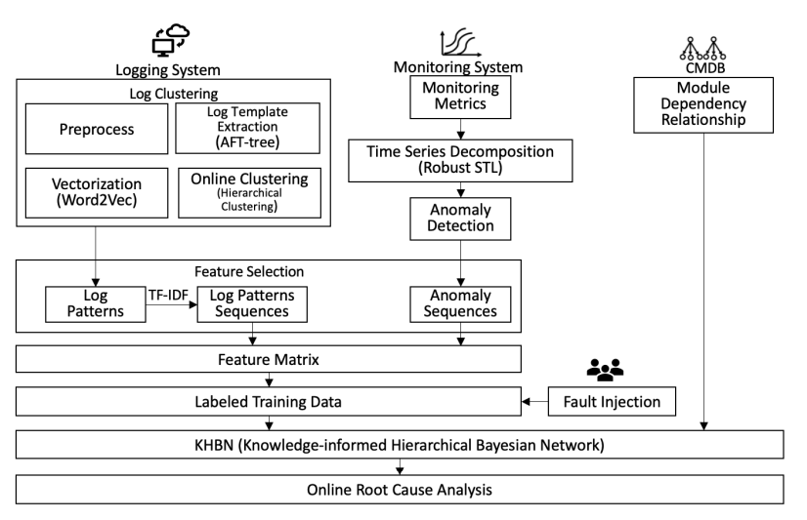
CloudRCA Framework

Slide 51
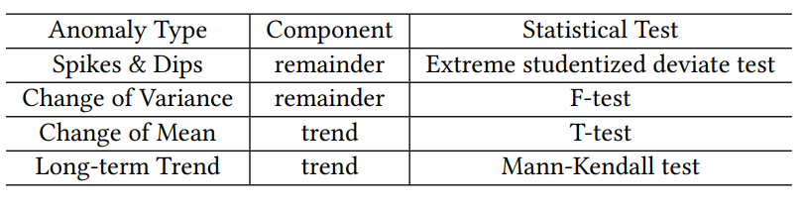
Metric Anomaly Detection
To detect periodicity, apply a simplified RobustPeriod algorithm[1]
Adopt wavelet transform to isolate single periodicity and then identifies the exact period
Decompose the time series into trend, seasonality, and remainder components by RobustSTL[2]
Extract the trend components by solving a regression problem
Estimates the seasonality component with a non-local seasonal filtering
With the decomposed time series, the author identify those anomalies in a “divide-and-conquer” manner
[1] Qingsong Wen, Kai He, Liang Sun, Yingying Zhang, Min Ke, and Huan Xu. 2021. RobustPeriod: Robust Time-Frequency Mining for Multiple Periodicity Detection. In Proceedings of the 2021 International Conference on Management of Data (SIGMOD)
[2] Qingsong Wen, Jingkun Gao, Xiaomin Song, Liang Sun, Huan Xu, and Shenghuo Zhu. 2019. RobustSTL: A robust seasonal-trend decomposition algorithm for long time series. In Proceedings of the AAAI Conference on Artificial Intelligence

Slide 52
Log Templates Extraction and Clustering
Apply Adaptive Frequent Template tree based on FT-tree[1] to obtain log templates
Use dictionaries to store children of nodes instead of lists
Use the number of leaves of a node for pruning instead of the number of children
Cluster them by the semantics with NLP algorithms
Apply Word2vec to obtain vector-representations of the logs
Perform hirearchical clustering based on the cosine similarity to aggregate logs into different clusters, which the author call log patterns
[1] Shenglin Zhang, Ying Liu, Weibin Meng, Zhiling Luo, Jiahao Bu, Sen Yang, Peixian Liang, Dan Pei, Jun Xu, Yuzhi Zhang, et al. 2018. Prefix: Switch failure prediction in datacenter networks. Proceedings of the ACM on Measurement and Analysis of Computing Systems

Slide 53
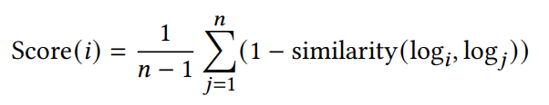
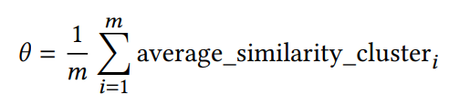
Clustering algorithm
First, conduct a offline training to obtain clusters
Select a representative log by choosing the center of the cluster
Compute a score for each log in a cluster based on its average distance to other logs within the same cluster
In the online mode, when a new log s comes, compute the similarity of the input log s with the representatives of existing clusters
If the similarity is above a threshold 𝜃, assign the input log to the cluster with the greatest similarity
Threshold can be calculated as
Otherwise, create a new cluster for s

Slide 54
Configuration Management Database
In addition to logs and monitoring metrics, the author also have tree-based data stored in Configuration Management Database(CMDB)
Complicated depedency relationships between modules and root cause types for issue-tracking
Transform the logging and monitoring data into standard feature data
Build time series for log patterns indicating whether a certain log pattern appears (marked 1) or not
Each monitoring item is marked 1 if it’s deemed as an anomaly by the algorithm

Slide 55
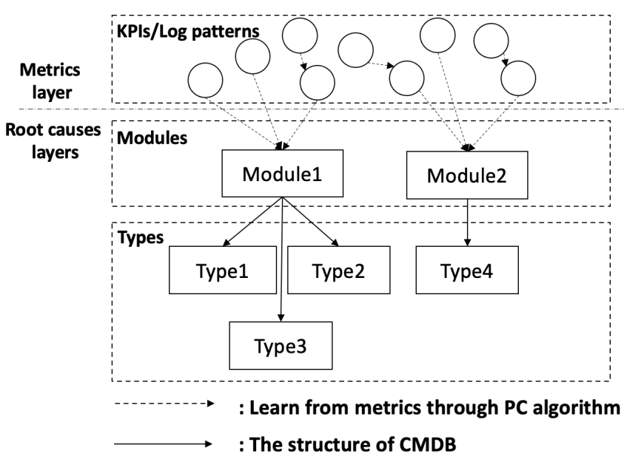
Knowledge-informed Hierarchical Bayesian Network

Slide 56

Knowledge-informed Hierarchical Bayesian Network
Causal relationship between nodes are constructed based on system metrics by PC algorithm[1]
Use topology information from CMDB to generate the edge between nodes
Calculate the conditional probability table of each node using the maximum likelihood estimate
When system fails
Input those feature data into KHBN model trained with historical data,
Select the node from the root cause types layer with the highest probability as the root cause
[1] Ping Wang, Jingmin Xu, Meng Ma, Weilan Lin, Disheng Pan, Yuan Wang, and Pengfei Chen. 2018. Cloudranger: Root cause identification for cloud native systems. In 2018 18th IEEE/ACM International Symposium on Cluster, Cloud and Grid Computing (CCGRID)

Slide 57
Experiment

Slide 58
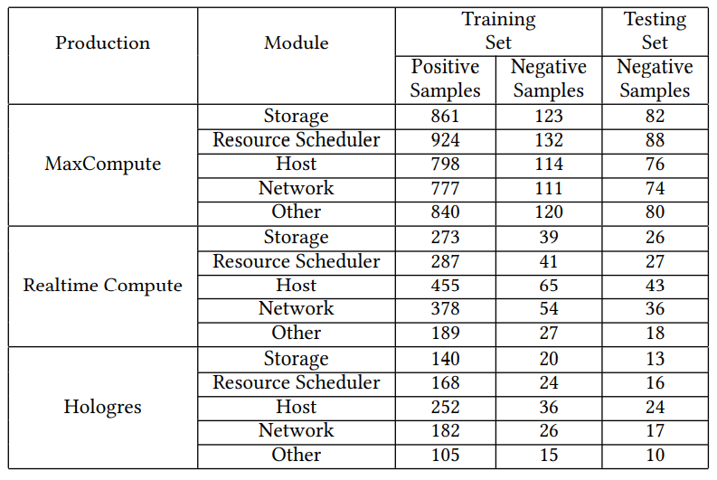
Datasets
Big data cloud computing platforms of Alibaba
MaxCompute
Realtime Compute
Hologres
Data over the past five years, including time series metrics, logs and tree-based data from CMDB, are collected from each platform
Notes:
SMAP and MSL are spacecraft datasets collected by NASA
TSA is a dataset collected from our own time-series anomaly detection system that processes time-series
TSA gathered two months metrics of services and hardwares from the Flink cluster of the system

Slide 59
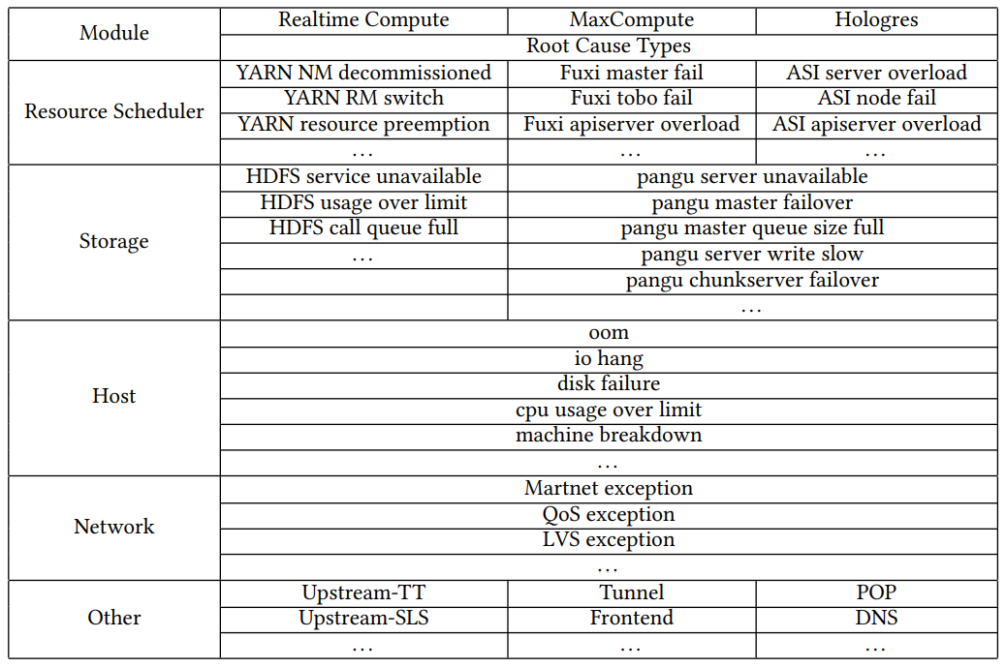
System Modules and Corresponding Root Cause Types of the Three Platforms

Slide 60
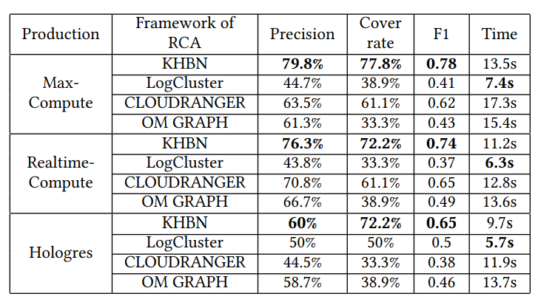
Performance of RCA methods

Slide 61
Conclusion
Problem
The limited coverage of log features makes it difficult for log-based methods
Correlation analysis-based methods don’t consider domain knowledge
Solution
Combine metric and log feature
Combine them with Configuration Management Database
Experiment
KHBN performs better than other methods

